Slide 1

Autonomous Helicopter Navigation System 2010

Slide 2
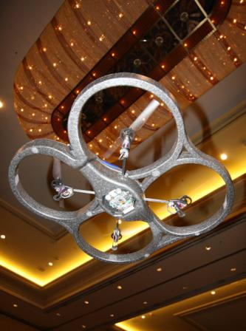
AHNS Project Aim
The Autonomous Helicopter Navigation System 2010 is focused on developing a helicopter system capable of autonomous control, navigation and localising within a GPS denied environment.

Slide 3
Project Management
Michael Hamilton - 06219314

Slide 4
Contents
Previous Years Achievements
High Level Objectives
Project Outcome Simulation
System Requirements
Project Role Division
Work Breakdown Structure
Finical Budget
Risk Management Plan
Next Semester Plan

Slide 5
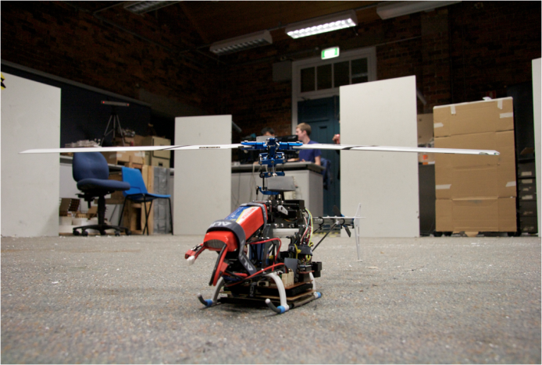
Previous Years Achievements
Autonomous Landing
Stabilisation with z-axis (height) with the use of IR range finder.
Control handled off-board on Ground Station
A human to machine interface developed.
Unsuccessful attempt at remote camera vision localisation.

Slide 6
High Level Objectives
HLO-1 Platform
A platform should be developed and maintained to facilitate flight and on board hardware integration.
HLO-2 Localisation
The system should be capable of determining its position with the aid of image processing within an indoor environment to an appropriate time resolution.
HLO-3 State Estimation
A method of estimating the states of the helicopter system should be designed and implemented. The resolution of the estimations should facilitate their employment in the control system design.

Slide 7
High Level Objectives
HLO-4 Autonomous Hovering Flight
An autopilot system should be developed to enable sustained indoor autonomous hovering flight. The control system should be designed to enable future ingress and egress manoeuvre to longitudinal and hovering flight.
HLO-5 Ground Control Station
A ground control station that supports appropriate command and system setting inputs and data display and logging should be developed. The design should be derived from previous AHNS developments and enable future ground station developments.
HLO-6 Communications
The communications system should enable transfer of control, state and localisation data to the ground control station. It should provide with a flexible wireless data link available on consumer-electronic devices.

Slide 8
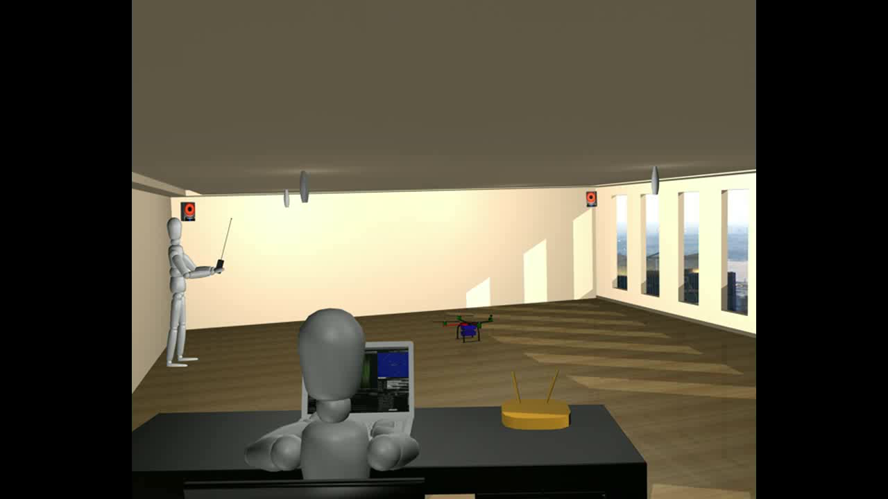
Project Outcome Simulation

Slide 9
Baseline System Requirements
Requirement | Definition
SR-B-01 | The platform shall have the ability to be manually manoeuvred with a radio controller.
SR-B-02 | The GCS shall enable autopilot flight mode switching between manual, stability augmented flight, and autonomous station keeping.
SR-B-03 | The airborne system shall provide control updates at a minimum rate of 50Hz.
SR-B-04 | The estimator shall provide Euler angle and rate estimation for the system at minimum rate of 50 Hz.
SR-B-05 | The estimator shall provide altitude estimation for the system at minimum rate of 50 Hz.
SR-B-06 | The estimator shall provide x and y estimation in an Earth fixed co-ordinate system at minimum rate of 50 Hz.
SR-B-07 | The system shall use image processing to aid in state estimation of x and y in an Earth fixed co-ordinate system.
SR-B-08 | The autopilot system gain and reference parameters shall be updatable in flight using an 802.11g WLAN uplink from the GCS.
SR-B-09 | The airborne system shall transmit telemetry data including state data to the GCS using 802.11g WLAN.
SR-B-10 | The autopilot control methodology shall be based on cascaded PID control loops.

Slide 10
Derived System Requirements
Requirement | Definition
SR-D-01 | The platform shall be capable of maintaining controlled flight with a total payload of 400 grams.
SR-D-02 | A maintenance document shall be used to log airframe flight time, battery cycles and aircraft repairs.
SR-D-03 | The autopilot shall provide stability augmented flight.
SR-D-04 | The autopilot shall provide autonomous station keeping capability within a 1 meter cubed volume of a desired position.
SR-D-05 | The airborne system shall receive and process measurement data from the state estimation and localisation sensors; supporting IMU, Camera, IR, Ultrasonic devices.
SR-D-06 | The airborne system shall collect avionics system health monitoring information in the form of radio control link status, flight mode status and battery level.
SR-D-07 | The airborne system shall transmit all actuator inputs, including radio control inputs, to the GCS.
SR-D-08 | The GCS shall log all telemetry and uplink data communications.
SR-D-09 | Aircraft state data and control inputs received shall be displayable on the GCS along with appropriate time references.
SR-D-10 | The GCS shall provide display of avionics system health monitoring including telemetry, uplink, radio control link and battery level status read-outs.

Slide 11
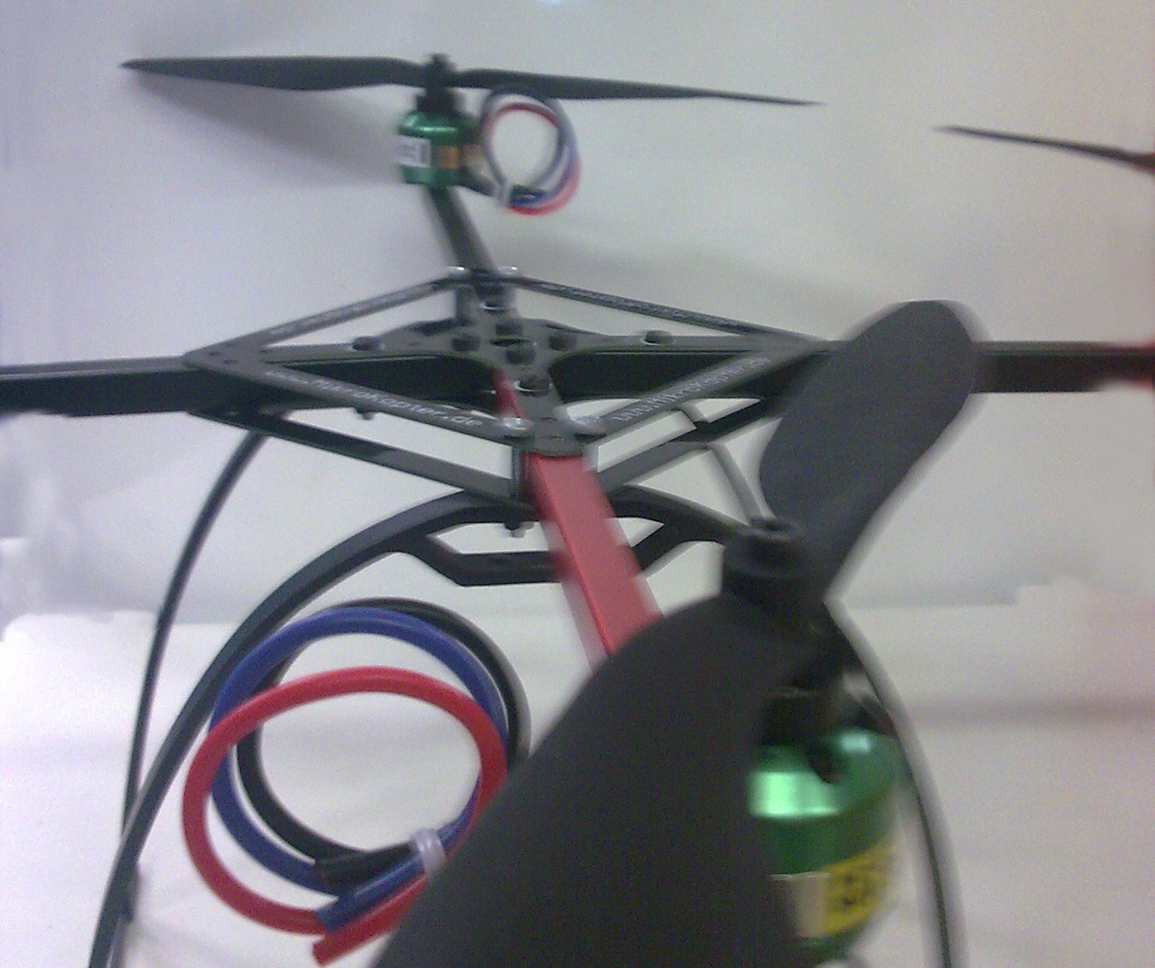
Project Role Division

Slide 12
Work Breakdown Structure
Preliminary Design Document
WP-SY-04
Wireless Communications Test Report
WP-CO-02
STAGE 4: Integration and
Testing
STAGE 5: Deliverables
Airframe Trade Study
WP-PL-01
Airframe RC Test Report
WP-PL-04
Flight Computer Trade Study
WP-AP-01
Design Control System
WP-AP-03
Electronic Test Report
WP-PL-05
Camera Bench Test Report
WP-LO-02
Design Computer Vision System
WP-LO-03
Design Ground Control Station
WP-CG-01
Design Wireless Communications
WP-AP-03
Acquire & Construct Airframe
WP-PL-02
System Requirements Document
WP-SY-02
Acquire Flight Computer
WP-AP-02
Design State Estimation
WP-SE-01
Acquire Platform Electronics
WP-PL-03
Project Management Plan Document
WP-SY-03
Acquire Camera
WP-LO-01
High Level Objective Document
WP-SY-01
STAGE 1: Definition and Research
STAGE 2: Design and Development
STAGE 3: Component Testing

Slide 13
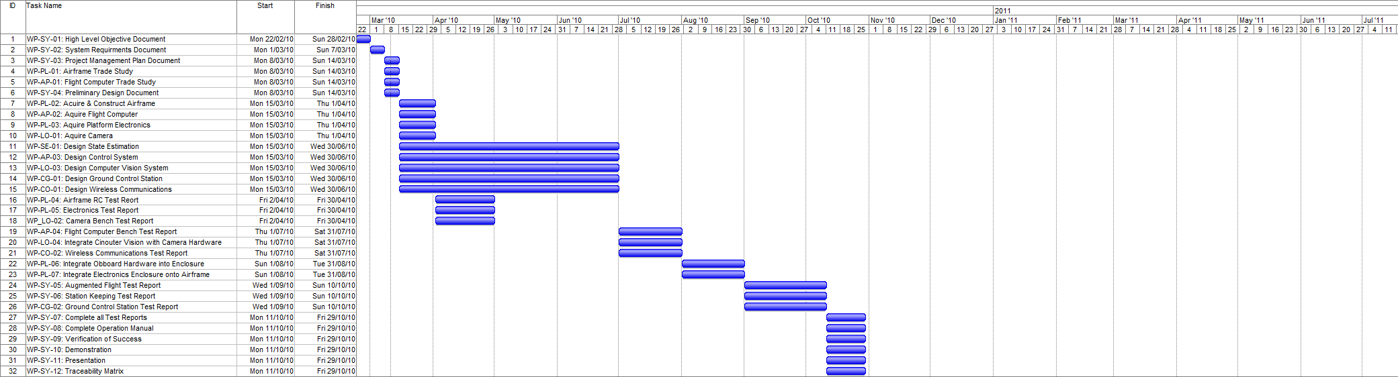
Timeline

Slide 14
Budget
Company | Items Description | Debit | Credit | Total
QUT | BEE Unit Funds | $0.00 | $400.00 | $400.00
Boeing | Boeing Sponsership | $0.00 | $2000.00 | $2400.00
HiSystems GmBH | Quad Copter Airframe | $759.86 | $0.00 | $1640.14
Surveyor Corporation | Camera | $248.75 | $0.00 | $1391.39
Gumstix inc | Onboard Computer | $395.92 | $0.00 | $995.47
HobbyRama | V-Tail Mixer | $19.95 | $0.00 | $975.52
HobbyRama | Cable | $13.00 | $0.00 | $962.52
HobbyRama | Cable | $49.00 | $0.00 | $913.52
Bunning’s Warehouse | Glue | $2.05 | $0.00 | $911.47
Bunning’s Warehouse | Tool | $13.98 | $0.00 | $897.49
Eckersley | Wiring Equipment | $29.95 | $0.00 | $867.54
QUT Bookshop | Writing Material | $5.70 | $0.00 | $861.84
Jaycar Autralia | Cable | $10.67 | $0.00 | $851.17
RS Components | Coolum Counter | $37.07 | $0.00 | $814.10
Farnel | Electrical Parts | $86.55 | $0.00 | $727.55
 |  |  | Total Remaining | $727.55

Slide 15
Risk Management
Risk Hazard Log
Risks Rated within standard “Risk Evaluation Table”
Risks Classified within five categories:
Personal Injury
Property Damage
Schedule
Technical
Budgetary

Slide 16
Next Semester
Integration of all sub-system components during Week 1 and 2.
Most of Semester Two will be devoted towards testing.
Utilising on-board camera to track ground target.
Purchase of secondary platform.

Slide 17
Testing Procedures
Michael Hamilton - 06219314

Slide 18
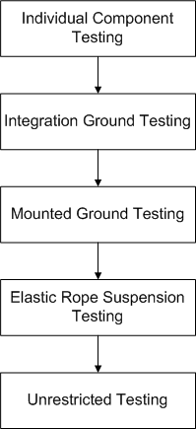
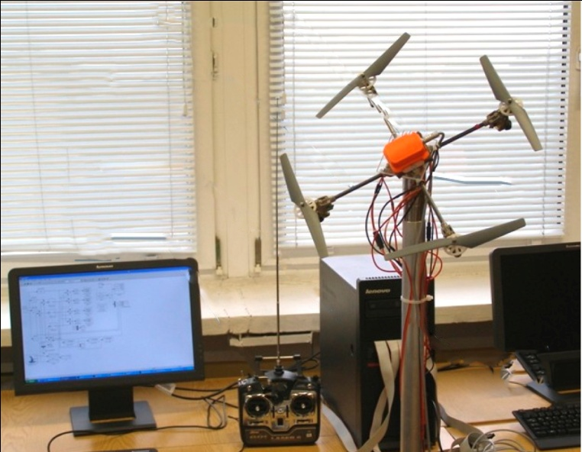
Tier Testing Procedure

Slide 19
Platform pilot
Michael Kincel - 06219322

Slide 20
Platform
HLO-1 Platform
SR-B-01 Manual RC Control
SR-D-01 400 Gram Payload
SR-D-02 Maintenance Document
Mode Control Unit
Airframe Trade Study

Slide 21
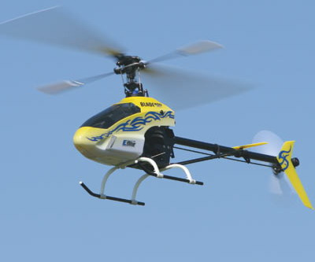
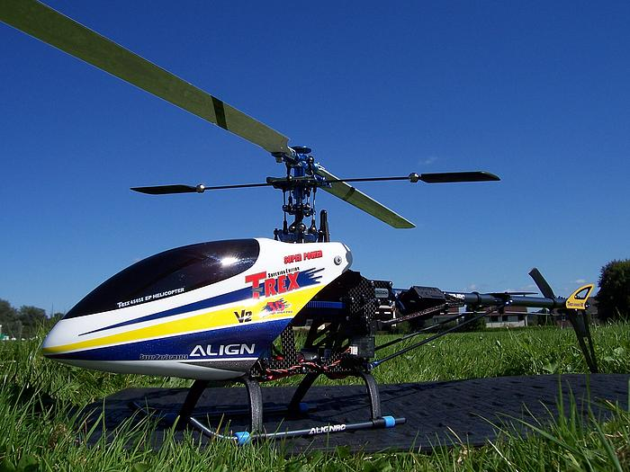
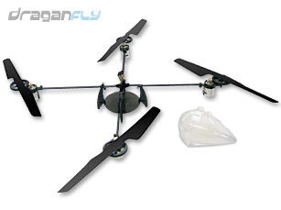
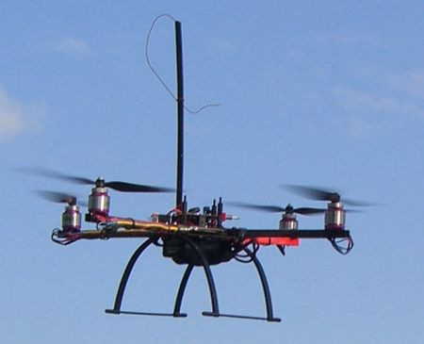
Airframe Trade Study
Mikrokopter MK40
 |  | Score (/5)
 | Weighting | 5 | 4 | 3 | 2 | 1
Initial Cost | 10% | < $700 | $700 – 799 | $800 - 899 | $900 - 999 | > $1000
Configuration | 20% | Airframe designed to have components mounted to it. | Components can be mounted to airframe with no modifications. | Components can be mounted to the airframe with minor modifications. | Components can be mounted to the airframe with major modifications | Impossible to mount components to airframe.
Acquisition and Maintenance | 15% | Can be acquired commercially and rarely requires simple repair. | Can be acquired commercially and repairable. | Can be bought however repair and maintenance expensive. | Not available commercially and difficult to build and repair. | Impractical to acquire; repair limited to rebuilding.
Vibration | 10% | Airframe generates minor vibrations but is designed with vibration dampeners. | Airframe generates minor vibrations and can have vibration dampeners installed. | Airframe generates major vibrations but is designed with vibration dampeners. | Airframe generates major vibrations but can have vibration dampeners installed. | Airframe generates major vibrations but cannot have vibration dampeners installed.
[SR-D-01] Payload | 30% | > 500g | 450 – 500g | 400 – 449g | 350 – 399g | < 350g
Safety | 10% | Airframe has no exposed moving parts. | Airframe has small exposed moving parts with low kinetic energy. | Airframe has small exposed moving parts with high kinetic energy. | Airframe has large exposed moving parts with small kinetic energy. | Airframe has large exposed moving parts with high kinetic energy.
Construction Material | 5% | Airframe is predominantly constructed out of light weight carbon fibre. | Airframe is predominantly constructed out of lightweight metal. | Airframe is predominantly constructed of heavyweight metal. | Airframe is predominantly constructed out of lightweight plastic. | Airframe is predominantly constructed out of heavyweight plastic

Slide 22
Hardware Architecture
Flight
Computer
Flight Control
Primary Sensors
Secondary
Sensor

Slide 23

Electronics Design
All circuits designed using Eagle PCB
Single circuit board design
Minimises weight and size
Minimises complexity through reduction in wire count
Difficult to debug
Difficult to modify prototype
Larger prototype stack verified first
Subsequent adaptation to single small PCB

Slide 24
Electronics Design
Development Stack Architecture
Main Board
MCU
IMU
Ultrasonic Sensor
Flight Computer
ADC

Slide 25
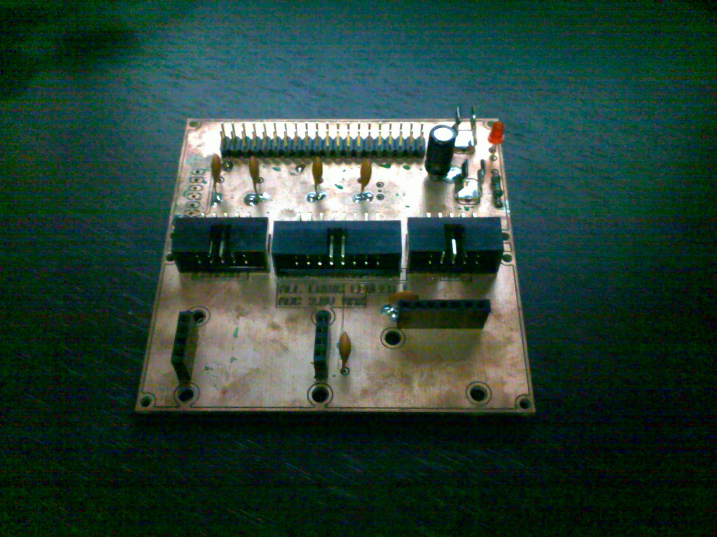
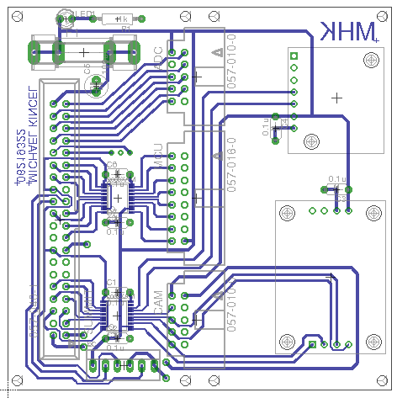
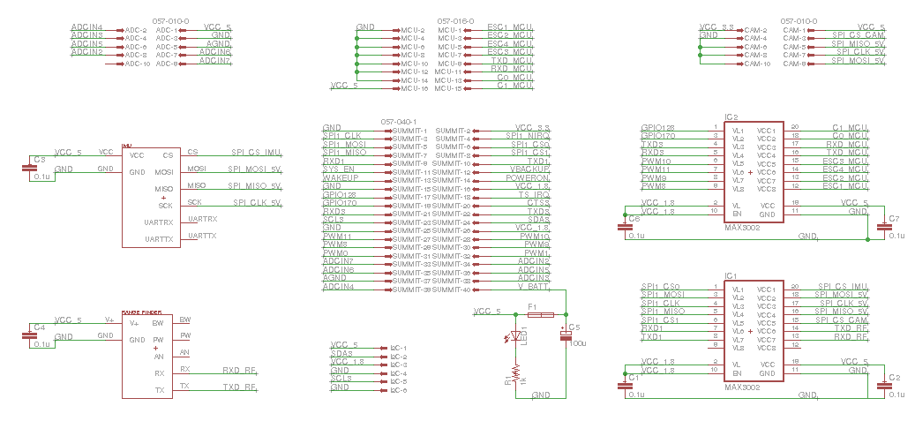
Electronics Design
Main Development Board

Slide 26
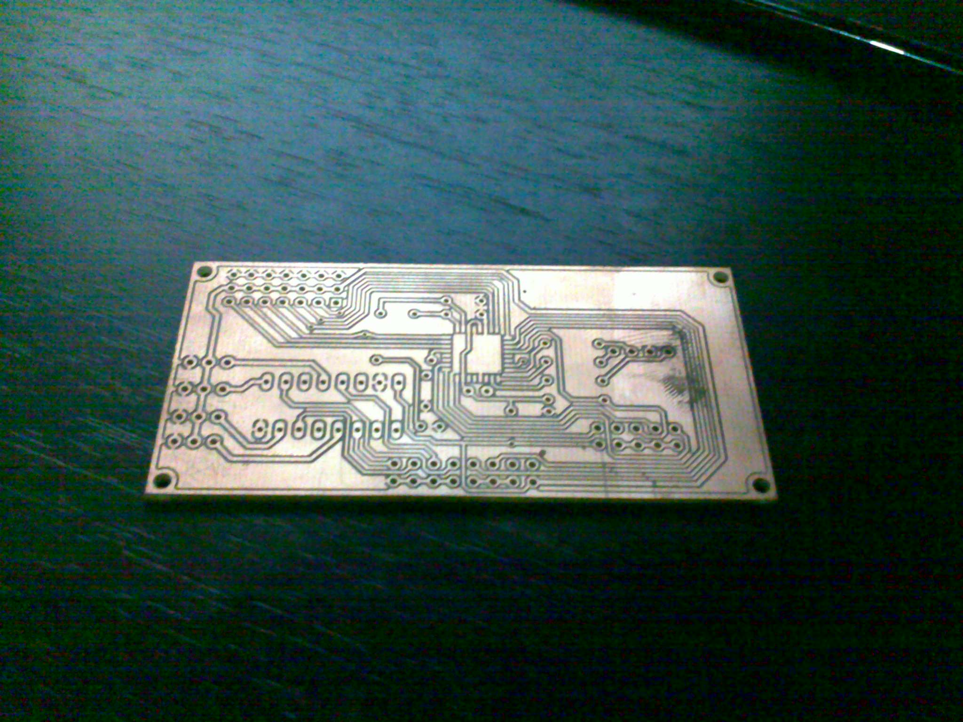
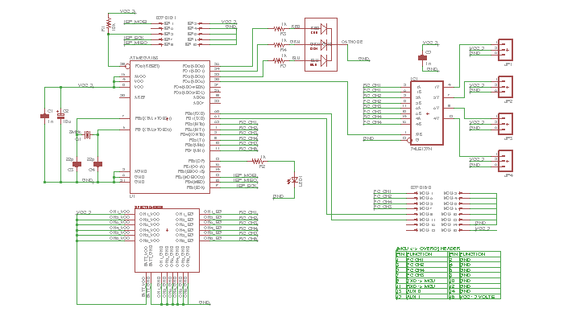
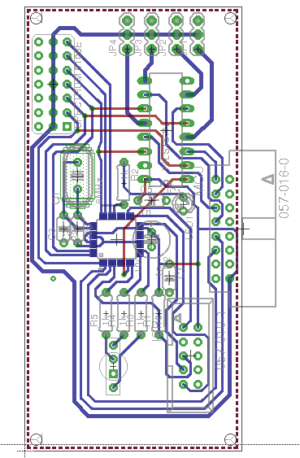
Electronics Design
Mode Control Unit

Slide 27
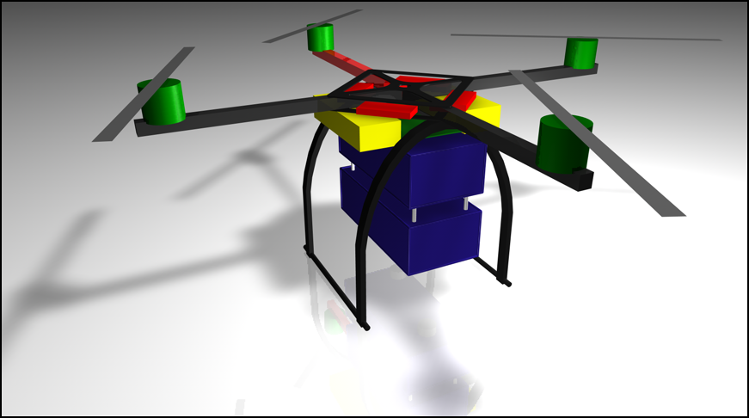
Enclosure Design

Slide 28
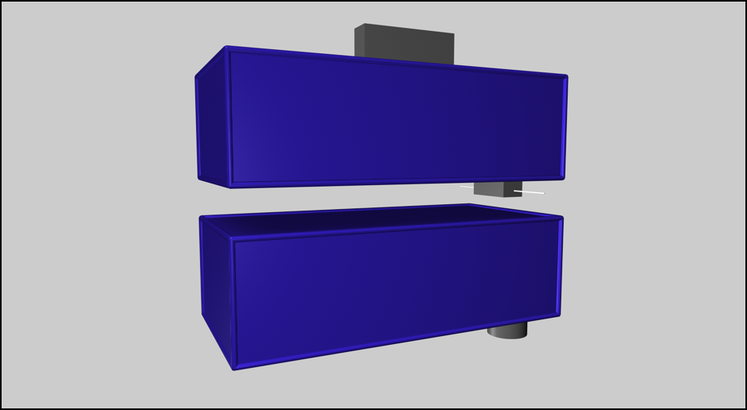
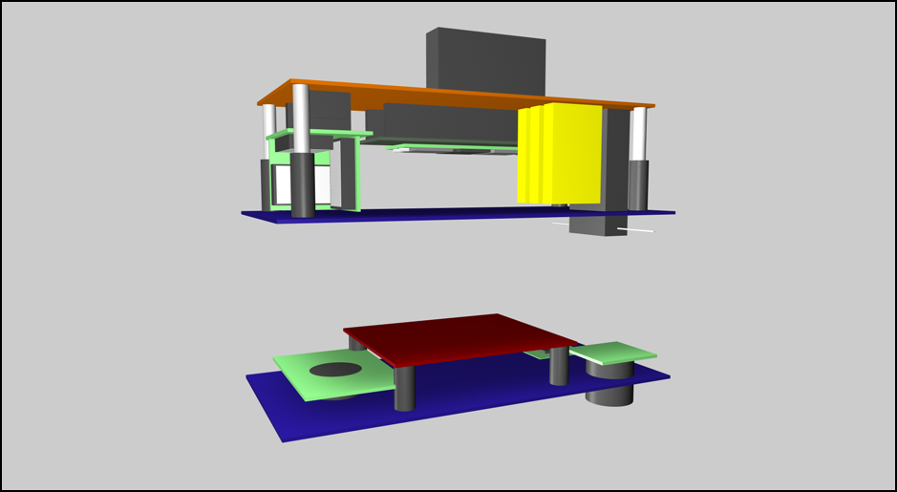
Enclosure Design

Slide 29
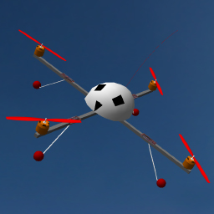
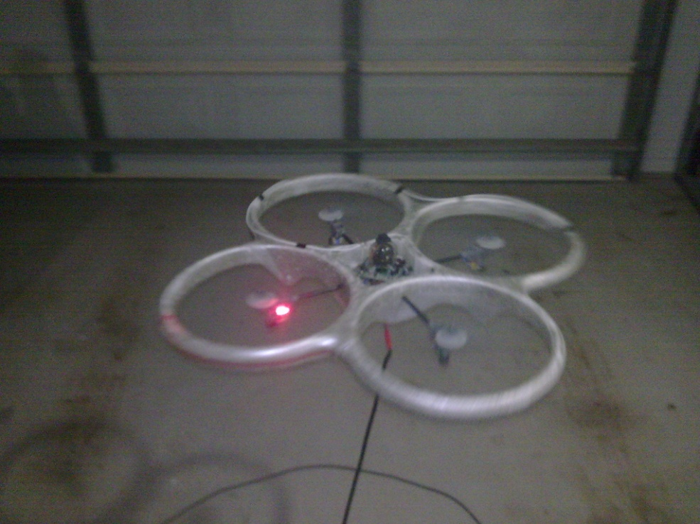
Piloting
RC Simulator
Weekly flights to maintain skill level
Practise recovery manoeuvres
Use of a practise aircraft
More resilient to damage
Less likely to incur damage

Slide 30
Ground Control Station Flight conTrol
Tim Molloy 06332064

Slide 31
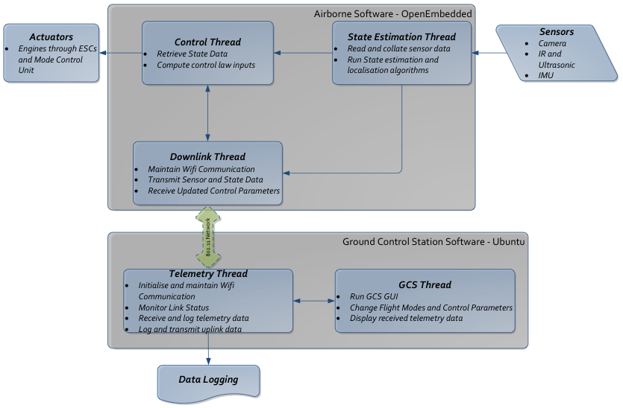
Software Architecture

Slide 32
Ground Control Station
HLO-5 Ground Control Station
SR-B-09 and 08 Receive and Transmit Telemetry via WLAN
SR-D-08 Log Telemetry and Uplink Commands
SR-D-09 Display of State and Control Data
SR-D-10 System Status Display
Received Console and Data Logger
Data Plotters & Artificial Horizon
System Status
WiFi Communications
SR-B-02 Flight Mode Switching
Not Yet Implemented

Slide 33
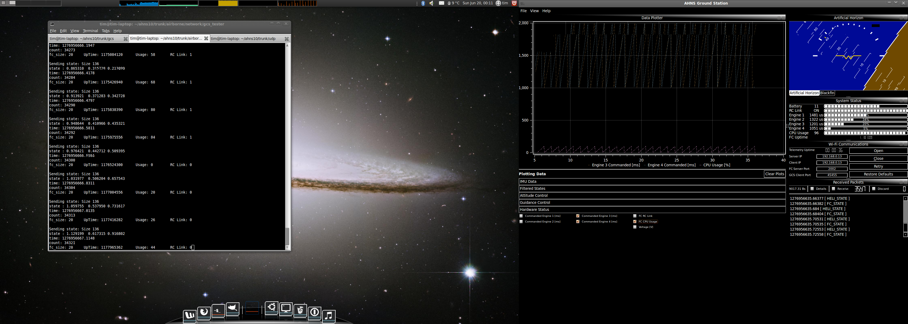
GCS GUI
Ubuntu 32-bit Operating System
Qt Framework for C++ GUI Development
Focus on:
Code reuse
Creating and using reusable code
User layout customisation
Avoid Static GUI objects
Dockable Widgets
Enable the operator to choose a layout logical to their application
Increases the information which can be displayed

Slide 34
The Widgets
WiFi Communications
Configure, Control and Monitor UDP Telemetry
Received Console
Report telemetry messages and enable inspection
System Status
Provide visual notifications of airborne system status
Data Logger
CSV Log of all Received Airborne Data

Slide 35
Data Plotters & Artificial Horizon
Artificial Horizon
2009 OpenGL Attitude Display
Roll and Pitch
Data Plotter
Real-time data plotting
Raw Sensor Data, State Data, Control Data, System Status…
Support for multiple data plotters

Slide 36
Following Controller Design…
Attitude Control Trims and Bounds
Set the trims and bounds on the roll, pitch and yaw control loops.
Attitude Control Gains
Set the PID control gains on the roll, pitch and yaw control loops.
Guidance Control Gains
Set the PID control gains on the x, y and z position control loops.
Guidance Trims and Bounds
Set the trims and bounds of the x, y and z position control loops.
Flight Control
Set the active control loops and their set points. Enables command of the airborne control.

Slide 37
Flight Control
HLO-4 Autonomous Hovering Flight
SR-B-03 50Hz Control Rate
SR-B-10 PID Control Methodology
SR-D-03 Stability Augmented Flight
SR-D-04 Autonomous Station-keeping
Flight Computer
Quadrotor Control
Attitude Control
Guidance

Slide 38
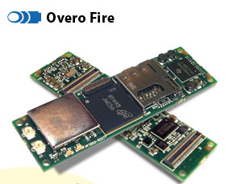
Flight Computer
Trade Study for Computer-on-Module to support
Hardware Integration
Control and State Estimation
Localization
Considered
BeagleBoard
Limited Hardware Interfacing
Gumstix Overo Air
Lacked Support for Image Processing
Gumstix Verdex
No Hardware Floating Point Implementation
Gumstix Overo Fire
6 grams, 600MHz TI CPU

Slide 39
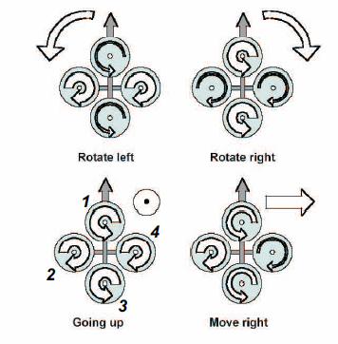
Quadrotor Control
Thrust Altitude Control Forces
Thrust Roll Control Forces
Thrust Pitch Control Forces
Drag Yaw Control Forces

Slide 40
Quadrotor Control
For an arbitrary combination of control inputs, the engine control signals are calculated with the mixing matrix shown:

Slide 41
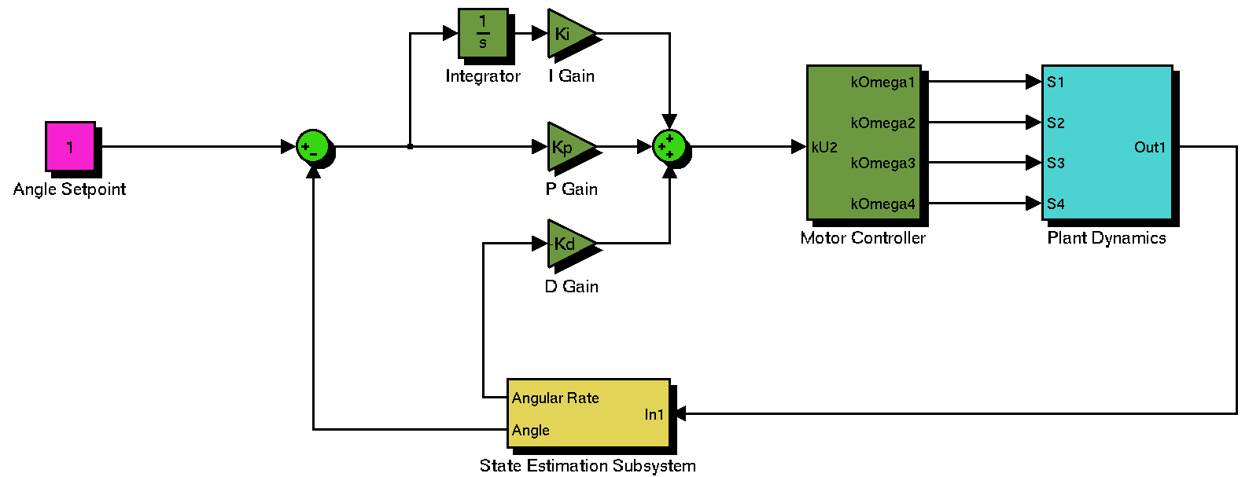
Quadrotor Control
Abstraction of motor thrust and drag control force variation reduces attitude control to three angular loops whose outputs are proportional to the required control forces, U₂, U₃ or U₄.

Slide 42
Guidance Progress
Three Angular Loops for Attitude Control plus up to Three Positional control loops
Altitude Control with input U₁
x-inertial position with roll and pitch loop setpoint
y-inertial position with roll and pitch loop setpoint
x and y position control presents some challenges
Requires use of Body and Inertial Reference Frames
Velocity Control using pitch and roll angle bounding
Options to decouple position errors or treat as cross-track error problem based on heading

Slide 43
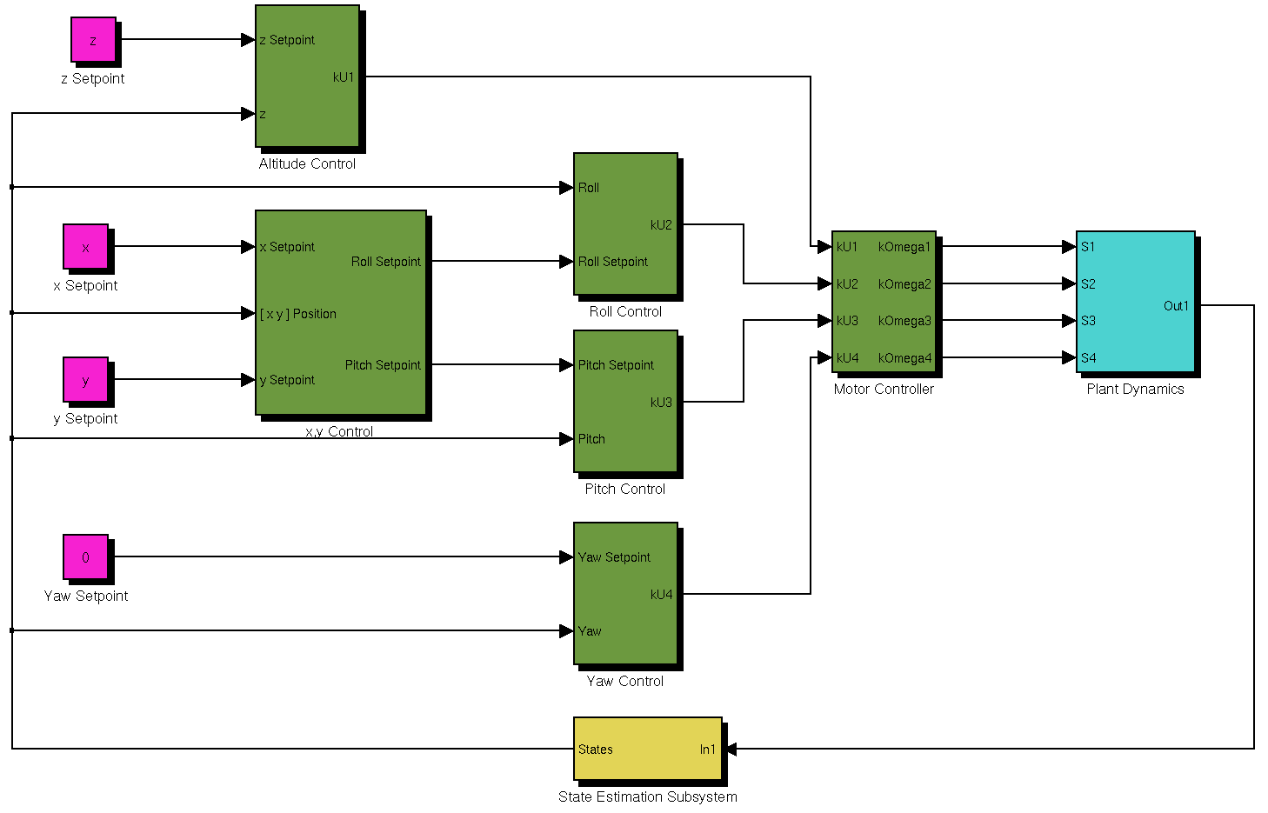
Cascaded PID Guidance And Control

Slide 44
Communication
Liam O’Sullivan - 06308627

Slide 45
Previous Years Communications
Used XBee RF 2.4 GHz modules for telemetry
Point to point communication (platform and GCS)
Disadvantages
Serial interface
Closed architecture (hard to expand)
User implemented synchronisation
No interface standard

Slide 46
Communications
HLO-5 Communications
SR-B-08 and 09 Transmit and Receive Telemetry via WLAN
WiFi Communication Design and Architecture

Slide 47
WiFi Communication Design
Server-client architecture
Main server onboard (devices connect to it)
Multiple device/client connections
Standard networking protocol (UDP and TCP)
Utilises ‘Heliconnect’ software library
Common network interface (headers)
Ability to communicate with other projects

Slide 48
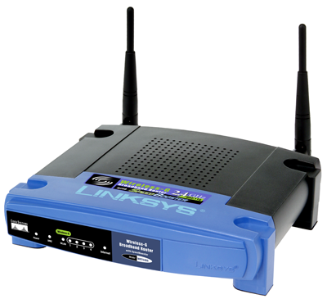
WiFi Architecture
Wireless adhoc network (point to point)
Unstable (particularly for non-Apple products)
Incompatible
Wireless router network
Centralised router
Devices communicate through the router
Uses Linksys WRT54GL
Internet gateway

Slide 49
Wireless Router Network

Slide 50
Communications Summary
WiFi design and architecture implemented
Stable and reliable UDP and TCP connections between server and clients
Multiple SSH connections between platform and clients
Successful connection between UDP server onboard with multiple GCS clients
Successful connection between TCP Blackfin Camera image feed and GCS client

Slide 51
State Estimation
Liam O’Sullivan - 06308627

Slide 52
State Estimation
HLO-3 State Estimation
SR-B-04, 05 and 06 50Hz State update
SR-D-05 Process Measurement Data
States and Sensors
Attitude Estimator and Kalman Filtering

Slide 53
Platform States
17 States to be measured
State | Sensor | State | Sensor
Roll rate | IMU and Vicon | X velocity | IMU* and Vicon
Pitch rate | IMU and Vicon | Y velocity | IMU* and Vicon
Yaw rate | IMU and Vicon | Z velocity | IMU* and Vicon
Roll | IMU* and Vicon | X displacement | IMU* and Vicon
Pitch | IMU* and Vicon | Y displacement | IMU* and Vicon
Yaw | IMU* and Vicon | Z displacement | IMU*, Altitude Sensor and Vicon
X acceleration | IMU and Vicon | X target | Blackfin Camera
Y acceleration | IMU and Vicon | Y target | Blackfin Camera
Z acceleration | IMU and Vicon

Slide 54
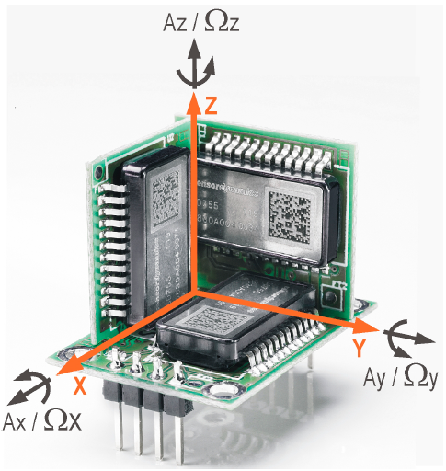
IMU
Sensor Dynamics 6 DOF IMU
3 gyroscopes and 3 accelerometers
Measures
Angular rates
Accelerations
Indirectly measures
Angles
Velocities
Displacements
75Hz update rate
SPI connection (with Overo Fire)
Inherited from AHNS 2009

Slide 55
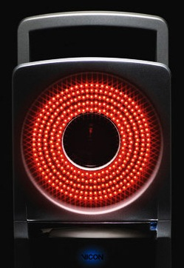
Vicon System
External motion capture system
Tracks reflective spheres with 5 IR cameras
Can measure all required states (except the camera tracking states) with sub mm accuracy
200Hz update rate
Ethernet connection (via GCS)
Not used for low level control (latency)
Verification and Validation tool
Located at the ARCAA building

Slide 56
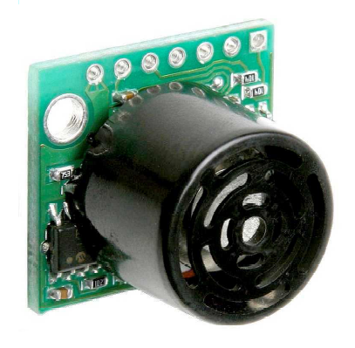
Altitude Sensor
Maxbotix ultrasonic sensor
Measures vertical displacement
Sonar range finder (not IR based)
Replaced by Vicon System
Still incorporated for redundancy
UART connection (with Overo Fire)
Inherited from 3rd year project

Slide 57
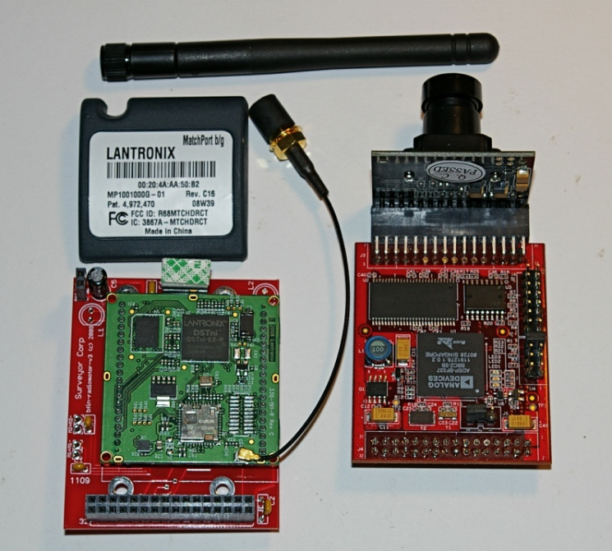
Surveyor SRV-1Blackfin Camera
Blackfin camera with Analog Devices processor
Embedded image processing (IP)
Interface and IP library
Get camera frame
Edge detection
Colour segmentation
Blob detection and others
WiFi connection (camera feed)
SPI connection (IP tracking states)
Recommended by Supervisor

Slide 58
Sensor Architecture

Slide 59
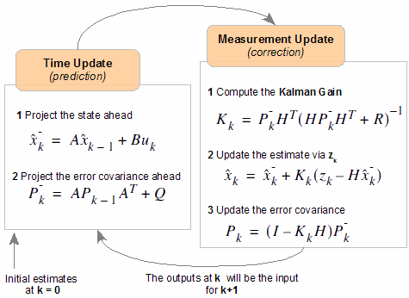
Kalman Filter and Sensor Fusion
IMU measurements are noisy and will drift
Require attitude estimator to correct for this
Will be based on the attitude estimator from AHNS 2009
Basic Kalman filter

Slide 60
Subsystem Progress and Future Work
All sensors are operational
Software interface libraries completed for
IMU (sensor data access through Overo Fire)
Blackfin Camera (image feed and command GCS widget)
Future work
Altitude sensor software interface
Vicon system client
Attitude estimator implementation

Slide 61
Localisation
Liam O’Sullivan - 06308627

Slide 62
Localisation
HLO-2 Localisation
SR-B-07 Estimation of X and Y displacement
Image Processing

Slide 63
Original Purpose
Blackfin Camera mounted underneath platform
Search for cross “blob” to localise itself (via IP)
Dead reckoning navigation from blob centroid (x and y displacement)

Slide 64
Updated Design
Newly integrated Vicon system eliminates need for dead reckoning
Will now perform a path tracking function for autonomous navigation (xt and yt displacement)

Slide 65
Localisation Summary
Success of this subsystem is dependent on all other subsystems
Re-evaluation of subsystem may need to occur if progress stalls on other subsystems

Slide 66
System DEMONSTRATION AND QUESTIONS

Slide 67
Michael HAMILTON - 06219314 MICHAEL KINCEL - 06219322 Tim MOLLOY - 06332064 Liam O’Sullivan - 06308627

